Slide 1
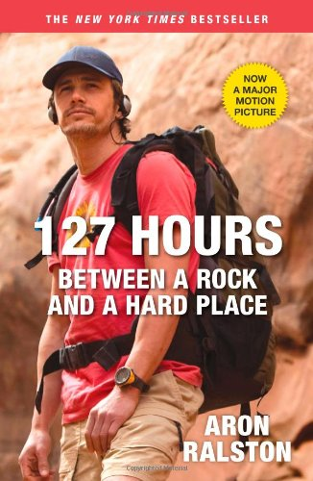
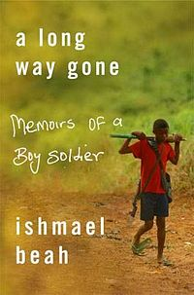
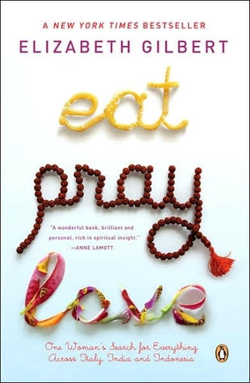
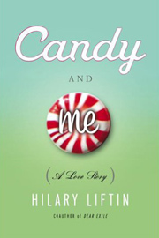
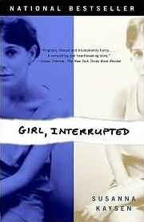

Slide 2
LIFE SENTENCES: The Six-Word Memoir
“Say it all
in six
words.”

Slide 3
Legend has it, Ernest Hemingway was challenged to write a short story in only six words. His response?
For sale:
baby shoes,
never worn.

Slide 4
SMITH magazine teamed with TWITTER for a Six-Word Memoir Contest in November 2006.
11,000 entries later, Not Quite What I Was Planning was published.
SMITH maintains a website dedicated to daily memoirs (caution advised for blunt language).

Slide 5
Follow-up editions include:
It All Changed in an Instant
I Can’t Keep My Own Secrets: Six-Word Memoirs by Teens with its own website
Six-Word Memoirs on Love & Heartbreak

Slide 7
The results are at times devastating, poignant, and hilarious. Each six-word memoir can jumpstart classroom discussion. Each is a nugget for a larger story, and universal themes abound.

Slide 8
Your Task
Write your own Six-Word Memoir and find the perfect illustration for your words. This will be shared, so think first.
Copy a blank slide at the end of this presentation.
Use your 6 words. Do not change font type or size.
Use your illustration. You may re-size it only slightly.
Use your name.

Slide 9
6 TIPS FOR GREAT 6-WORD MEMOIRS
by Rachel Fershleiser
Be specific.
Be honest.
Forget the thesaurus.
Use your own speaking voice.
Experiment with structure. Two three-word sentences. Three two-word sentences. One statement or six separate ones. Repetition can be powerful and punctuation is our friend.

Slide 10
6 TIPS FOR GREAT 6-WORD MEMOIRS
by Rachel Fershleiser
Stop trying so hard. Write carelessly; edit carefully. Throw a million ideas down and then decide. These aren't epic novels or Supreme Court decisions. Just start scribbling and see what catches your eye. In our experience, peoples' first instincts are usually the best.

Slide 11
No Flowers
No Funeral
No Nothing
I found my mother’s suicide note.
Anne Kitchen

Slide 12
I will be that cat lady. Carol Hardeman

Slide 13
Life: Dream big! Revise. Edit. Repeat.Becky Alfaro
I only tell truth in journals. Sarah White

Slide 14
A house without pets isn't home.Jennifer Swedoski
Finally learned “weird” is a compliment. Kathryn Andrews

Slide 15
I stopped reading between the lines.
Alix Frank

Slide 16
I always imagine clowns without makeup.
Jordan Harris

Slide 17
Missing = Four sisters, four time zones. Lizzy Allred

Slide 18
I lost more than my innocence. Mark Lott

Slide 19
In honor of my dad, I devote the following memoir.
Drained his strength, not his will. Drayce Howard

Slide 20
Doneness counts, but not done yet. Sandra Effinger
Doneness counts, but not done yet.
Sandra Effinger

Slide 21
Discussion Question
How is it both possible and impossible to distill the essence of who you are into six words? Which of these authors do you think did the best job of it and why?

Slide 22
Put your six words here, please.
First Last

Slide 23
Put your six words here, please.
First Last

